Slide 1


Predictive Analytics for Enhanced Customer
Engagement: A Data-Driven Approach
Mid-term presentation of Major Project submitted
in partial fulfilment of the requirements for the award of the degree of
BACHELOR OF TECHNOLOGY
IN
BIOTECHNOLOGY
by
NIKHIL KUMAR [BTECH/10883/22]
Under the Supervision of
Ms. Lakshmi Narayanan P.
( Chief Data Scientist)
Innovate
&
Internal Guide
Dr. DM Pandey
Department of Bioengineering and Biotechnology
Birla Institute of Technology, Mesra
Ranchi - 835215, Jharkhand
SP-2026

Slide 2
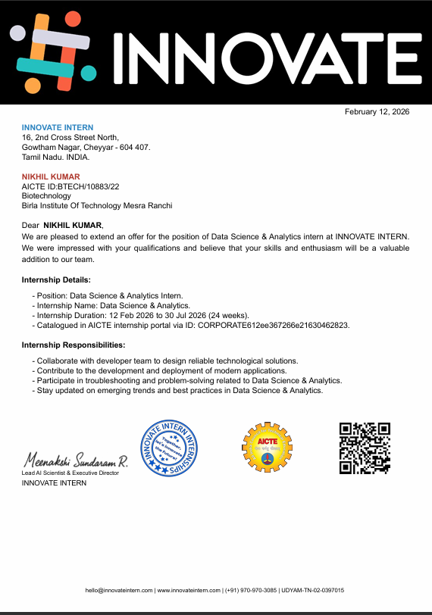

Slide 3
COMPANY OVERVIEW
At Innovate, we believe that "early-stage startups don’t fail because of lack of ideas - they fail because of execution gaps and operational bottlenecks."
We are a startup built to help other startups grow.
Our mission is simple: support small and early-stage startups in solving their real business problems through a bottom-neck approach - identifying the exact operational, technical, or strategic bottlenecks that slow down growth and fixing them with practical solutions.
We work closely with founders to understand their challenges across areas such as product development, operations, data analysis, technology implementation, and business strategy. Instead of offering generic advice, we focus on hands-on problem solving and execution.
Innovate operates as a collaborative platform of engineers, analysts, and problem solvers who work together to help startups move faster, build better systems, and scale efficiently.

Slide 4
Responsibilities In Company
My Role : Data Science & Analytics Intern
Key Responsibilities:
Analyzed startup business and operational data to identify growth bottlenecks and inefficiencies.
Built data-driven solutions and analytical models to support startup decision-making and process optimization.
Collaborated with developers to design and implement modern data-driven applications.
Assisted in deployment and troubleshooting of analytics workflows and tools used in startup problem solving.
Researched emerging trends in data science, analytics, and AI to improve startup solutions.

Slide 5
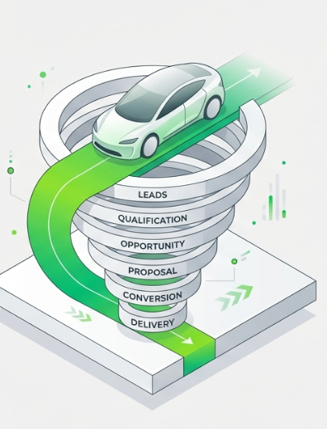
PROJECT OBJECTIVE
Analyze the end-to-end lead and store operations, create a dashboard, and tell a clear story with insights and recommendations.
Background:
ElectricPe operates Mobility Centres that connect customers to top electric 2-wheeler brands. Efficient management of leads, pre-bookings, bookings, deliveries, cancellations, and service follow-ups is critical for maximizing conversions and customer satisfaction.
Aim:
Build a data-driven dashboard that helps management optimize lead conversions and overall operational efficiency

Slide 6
Technical Stack & Design
Core Tool: Microsoft Excel (for data cleaning, analysis, and dashboard creation)
Key Features Used:
Pivot Tables & Slicers: For interactive filtering and KPI generation
Power Query: For data transformation and cleaning
Conditional Formatting: For highlighting high-potential leads
Design Theme: Clean, Modern, and Executive, featuring a Light Gray background, an Electric Green to Lime header gradient, and specific accent colors (Blue, Orange, Green).

Slide 7
Key Metrics Tracked
Total Leads & Deliveries:
Tracking incoming customer leads versus successful vehicle deliveries.
Cancellations & Conversion Rate:
Monitoring lost leads and the percentage of leads that converted into deliveries.
Average TAT (Turnaround Time):
Measuring the average time between lead-to-booking and booking-to-delivery.
Average NPS (Net Promoter Score):
Assessing overall customer satisfaction ratings.
Lead Temperature:
Distribution of leads categorized as Hot, Warm, or Cold based on activity.

Slide 8
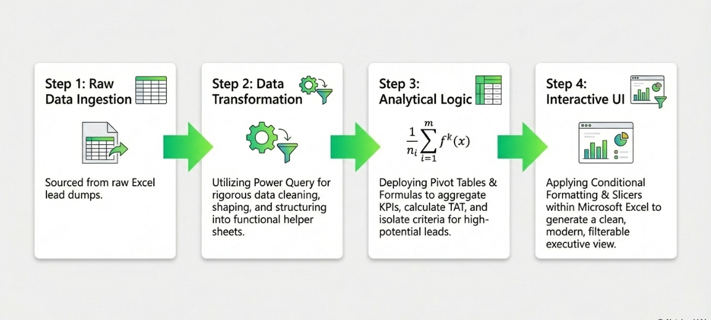
METHODOLOGY

Slide 9
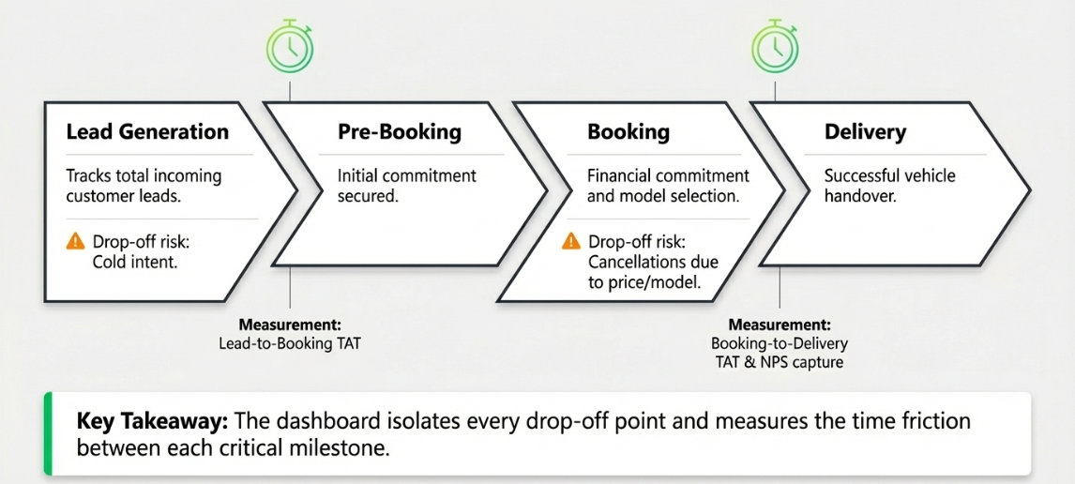
Visualizing the Lead-to-Delivery Journey

Slide 10
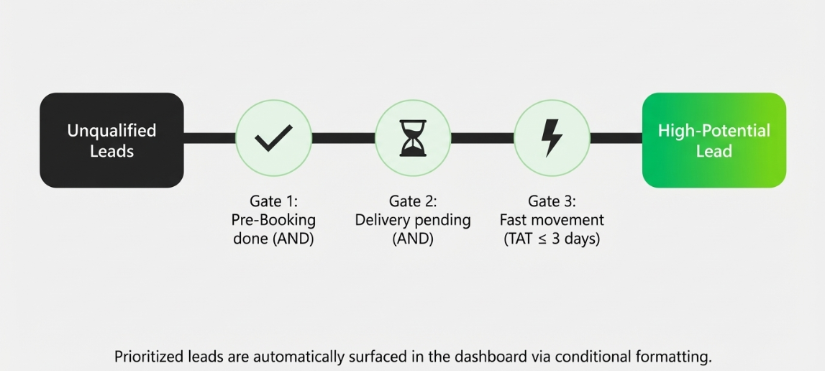
Isolating high-potential leads to prioritize sales efforts

Slide 11
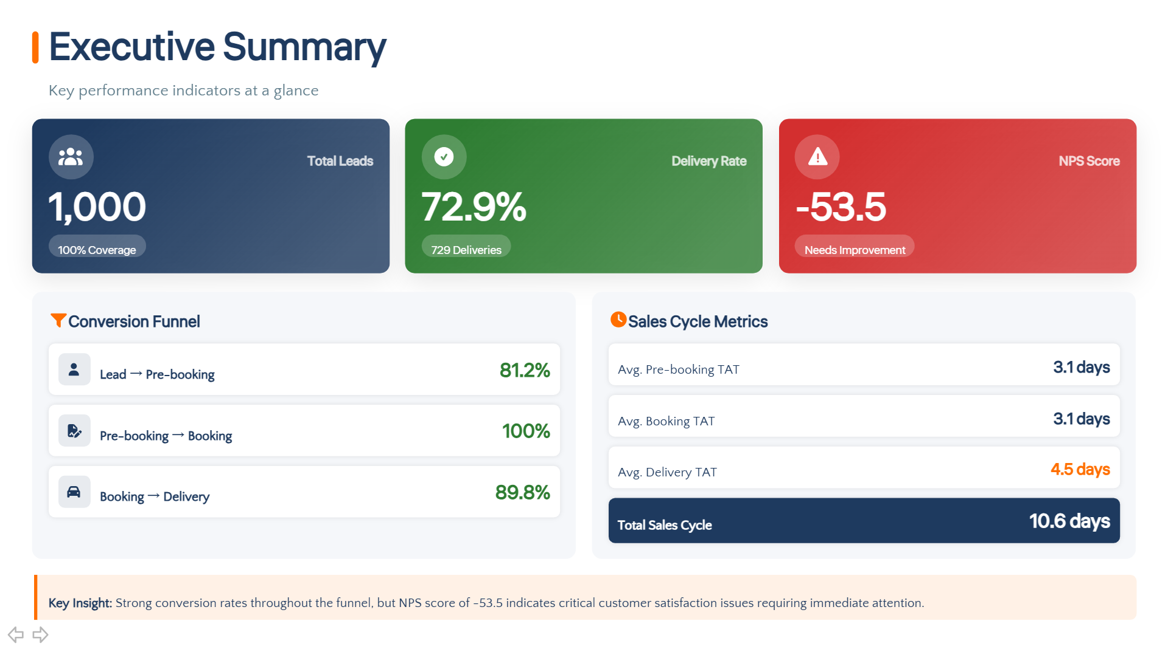
FUTURE GOAL

Slide 12
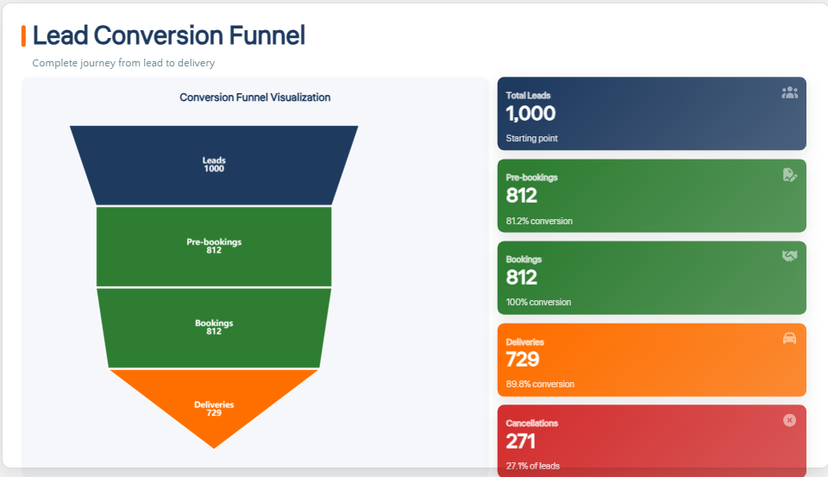
FUTURE GOAL

Slide 13
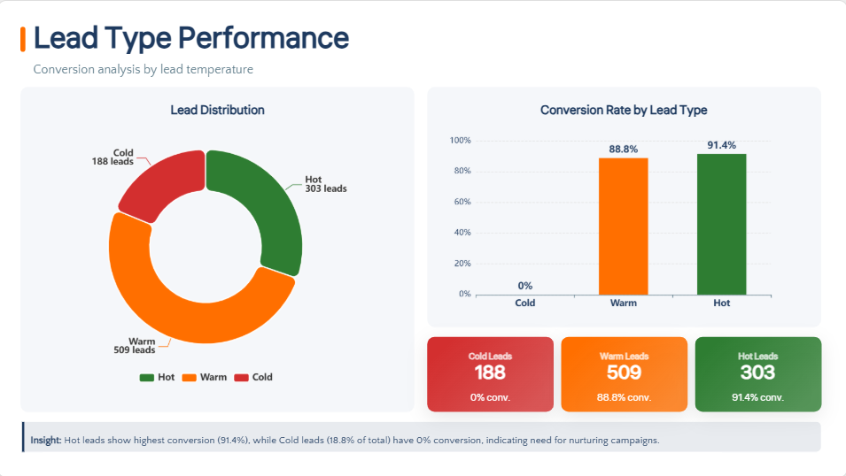
FUTURE GOAL

Slide 14
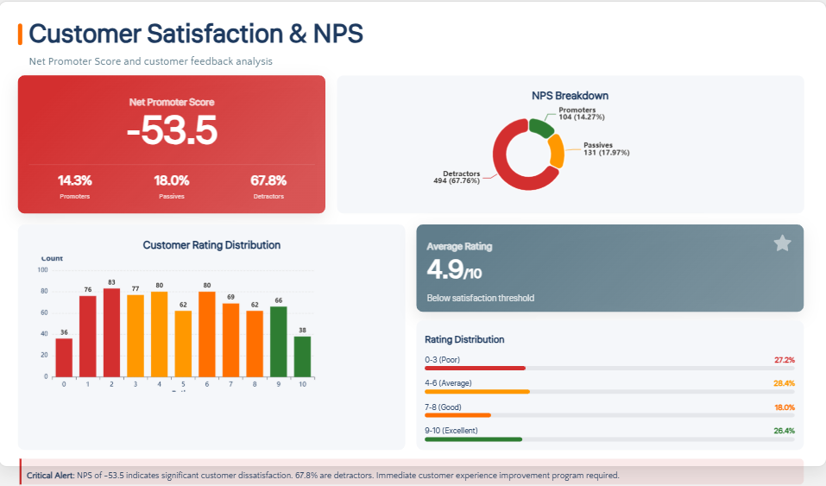
FUTURE GOAL

Slide 15
CONCLUSION
Key Insights
• Overall conversion: 72.9% (1,000 → 812 → 729).
Mumbai highest (76%), Delhi lowest (70.7%).
• Main drop-off: Pre-Booking (81.2%) due to slow manual follow-ups.
• Avg. TAT: 10.6 days → Delivery stage (4.5 days) is key delay.
Chennai slowest; Delhi fastest.
• Cancellations: 27% — top causes: Price 24%, Financing 23%, Changed Mind 20%.
• NPS: -53.5 overall; all stores negative. Chennai slightly better.
• Lead mix: 51% Warm, 30% Hot — Warm segment under-leveraged.
.
Remedies
• Automate CRM & lead scoring (focus Hot/Warm).
• Digitize pre-booking + instant confirmation.
• Standardize 10-day delivery SOP; live TAT dashboard.
• NBFC tie-ups for quick finance approvals.
• 7-day NPS follow-up calls & service reminders
Reasons
1. Manual pre-booking & unprioritized lead follow-ups.
2. Delivery process not standardized across stores.
3. Financing delays, unclear EMI options.
4. Weak post-delivery engagement → low NPS.

Slide 16
THANK YOU

